Slide 1

UNIVERSITY OF MESSINA
Department
Cognitive Science and Theory of Communication – LM-55
Course Title
SOCIAL SEMIOTICS
Teacher
Maria Rita Bartolomei
Mail: mabartolomei@unime.it

Slide 2

SOCIAL SEMIOTICS
Communication as semiotic work and meaning
Communication shapes the domain of meaning
Communication is itself a form of social action, of social work
in producing meaning
The forms, processes and contents of communication are socially
shaped
Communication is embedded in social environments, arrangements
and practices

Slide 3
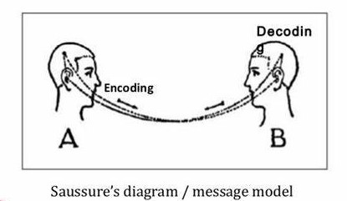
SOCIAL SEMIOTICS
The Saussure’s scheme of communication
Two interlocutors are linked in a dyadic structure

Slide 4
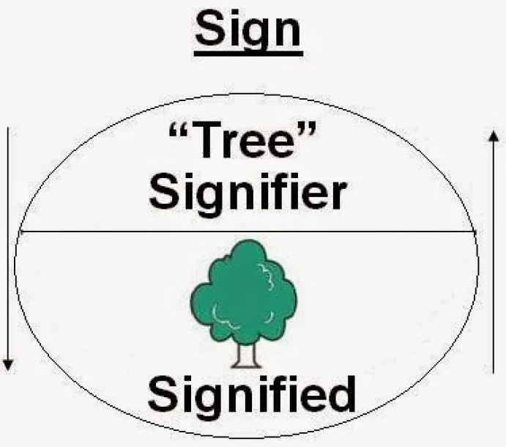
SOCIAL SEMIOTICS
The basic unit of signification is the sign
Signifier: the sound image
Signified: the concept
The relationship is conventional and arbitrary

Slide 5
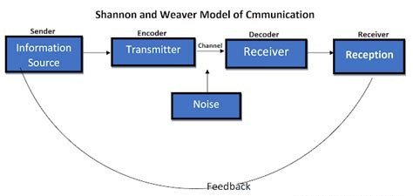
SOCIAL SEMIOTICS
The scheme of Shannon and Waver

Slide 6
SOCIAL SEMIOTICS
The authors intend their model as a general model which can be applied to any form of communication
Much criticism focuses on its simplicity as a linear transmission model
The message cannot be understood as a form of preexisting information
It does not exist before it is articulated
Encoding is itself a creative process which create the content
Communication is usually more interactive
We cannot leave out social aspects of communication

Slide 7
SOCIAL SEMIOTICS
The theory of Gunther Kress
Three concerns are in focus:
Social interaction and interchange around meaning
Resources for making meaning
Conditions and means for disseminating meaning

Slide 8
SOCIAL SEMIOTICS
Social interaction and interchange around meaning
Communication is an always complex interaction embedded
in social environments
The social divergences/differences between those who interact provide the “generative dynamic” of communication
Differences are reshaped into temporary social and semiotic accommodations
Sign-makers and their agency as social actors participate in the remaking of their social environment

Slide 9
SOCIAL SEMIOTICS
Social interaction and interchange around meaning
The semiotic work of interaction is always socially productive
In communication members of a community participate in the renewing of their social environment from the perspective of meaning
Social interaction via semiotic means produces new meanings
The social is re-calibrated, re-registered with semiotic cultural resources

Slide 10
SOCIAL SEMIOTICS
Resources for making meaning
Cultural Resources are values, rites, norms, texts or actions which lead to a common understanding
Mode is a socially shaped and culturally given semiotic resource for making meaning
There are many modes used in communication and representation: image, writing, layout, music, gesture, speech, moving image, 3D objects, etc.
Modes are the product of social work
Modes have meaning in their cultural environments
Language is no longer as central and dominant in expressing all meanings

Slide 11
SOCIAL SEMIOTICS
Resources for making meaning
Different modes offer different potentials for making meaning
Semiotic resources have specific forms in different cultures
Equal emphasis is placed on the affordances of the material stuff of the mode
Social work with the “same” material – sound – can lead to very different modes
These rest on different uses of the affordances of the same material features
The social work performed by members of social groups with the affordances of the material, produces semiotic resources

Slide 12
SOCIAL SEMIOTICS
Conditions and means for disseminating meaning
The social ha priority
The forms, processes and contents of communication are social
Communication
is embedded in social environments and practices
is itself a form of social action
is always a response by one participant to a prompt by other participants

Slide 13
SOCIAL SEMIOTICS
Conditions and means for disseminating meaning
Participants in communication
are embedded in networks of social relations with others
create meanings by making signs
Signs and sign-complexes – messages – have structure and content representing the interest of the sign-makers

Slide 14
SOCIAL SEMIOTICS
Conditions and means for disseminating meaning
The three central assumptions
Communication is the response to a prompt
Communication happens only when there is “interpretation”
Communication is always multimodal

Slide 15
SOCIAL SEMIOTICS
Conditions and means for disseminating meaning
Communication is the response to a prompt
A message becomes a prompt only when it is taken as such by another
Communication happens only when there is “interpretation”
An interpretation is a response to a prior prompt
Attention to the prompt derives from the participant’s interest
Interpreter and interpretation are central in communication

Slide 16
SOCIAL SEMIOTICS
Conditions and means for disseminating meaning
Communication is always multimodal
There are many modes used in communication and representation
We usually use multiple modes in the same sign

Slide 17

SOCIAL SEMIOTICS
Conditions and means for disseminating meaning
In this poster we have four modes in the same sign:
writing, logos, images and colours
Writing names
Image shows
Logo symbolizes and informs
Colour frames and highlights

Slide 18
SOCIAL SEMIOTICS
Conditions and means for disseminating meaning
Each mode has its distinct potential for meaning
The signs can be different
in the mode used
in how the modes are used
Multimodality
Can tell us what modes are used
Cannot tell us about this difference in style, what that difference would mean

Slide 19
SOCIAL SEMIOTICS
Conditions and means for disseminating meaning
Social semiotics – A theory which deals with meaning
in all its appearances
in all social occasions
in all cultural sites

